Slide 1
Analysis and Mitigation of Radiation Induced Errors In Modern Circuits
Dissertation Defense
Adam Watkins
Advisor: Spyros Tragoudas

Slide 2
Outline
Introduction
Robust Latches for Multiple Node Upsets
Analytical Approximation Model for Multiple Transients
Accurate Soft Error Simulator Using Partitioning
Conclusion

Slide 3
Introduction
This defense focuses on the effects of soft errors
Soft Error
Temporary error – induced by a radiation particle
Occurs when a particle strikes the sensitive volume of a transistor
Two types of soft error investigated
Single Event Transient (SET) – a temporary voltage pulse
Single Event Upset (SEU) – SET is propagated to latch input or value is flipped in latch
A particle striking a transistor does not guarantee an error
Decrease in feature size has increased the likelihood of error

Slide 4
Introduction
3 novel mitigation and estimation approaches proposed
Chapter 1
A soft error tolerant latch suitable for clock gating
Capable of tolerating double node upsets (DNUs)
A study on a triple node upset (TNU) tolerant latch is conducted
Chapter 2
Accurate pulse shape approximation method
Considers multiple pulses on the gate input
Chapter 3
FAST_MET simulation tool - calculates the soft error rate (SER)
Uses partitioning, Boolean functions and accurate pulse shape approximation

Slide 5
Outline
Introduction
Robust Latch for Multiple Node Upsets
Analytical Approximation Model for Multiple Transients
Accurate Soft Error Simulation Using Partitioning
Conclusion

Slide 6
Robust Latch for Multiple Node Upsets
Existing designs can tolerate single node upsets (SNUs) and DNUs
Many are not suited for clock gating
Use a weak keeper on a c-element
Proposed design recovers all nodes after error
Is the most efficient design for use in clock gating
Is DNU robust
Is DNU tolerant
No high impedance states after a DNU
C-element with a weak keeper on the output

Slide 7
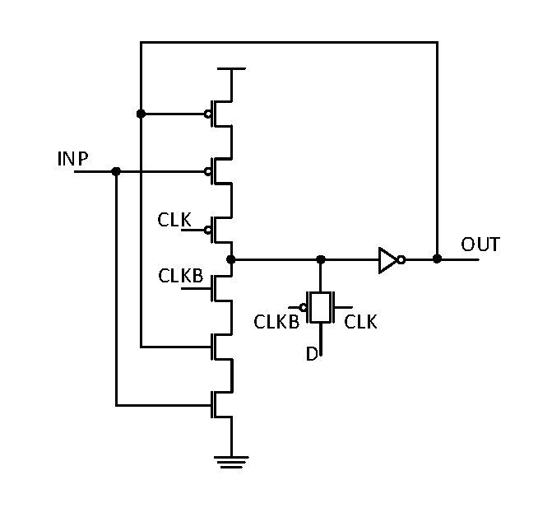
Proposed DNU Tolerant Latch
Proposed latch is based on 3 block latches connected to a c-element
The block based latch is not DNU resilient or robust
Block based latch
Basic data storage block

Slide 8
HRDNUT Latch
Block based latch is modified so no signal drives itself
Leads to the Highly Robust Double Node Upset Tolerant (HRDNUT) latch
HRDNUT is DNU robust since all nodes recover to their correct state after a DNU
HRDNUT Latch

Slide 9
HRDNUT Normal Operation
Data loop in the HRDNUT indicated in red
Transparent Mode
3 pass gates are activated
Data is loaded to nodes OUT, n1 and n2
This sets in inputs of C3, thus setting n3
C4, C5, C6 and C7 are set, thus setting the value
Hold Mode
The pass gates are deactivated
A loop is formed between C1, C2 and C3 holding the data (in red)

Slide 10
HRDNUT Operation During a DNU
Assume n2 and n3 will change values due to a DNU
Transient on n2 (in red)
Blocked by C4 since it is driven by OUT
Propagated to the NMOS on C5 and PMOS on C6
Transient on n3 (in blue)
Blocked at C2 since n4 does not change
Propagated to C6, could change the value on n6 if error goes to 0 (in green)
Error is blocked at C7 since n1 does not have a transient

Slide 11
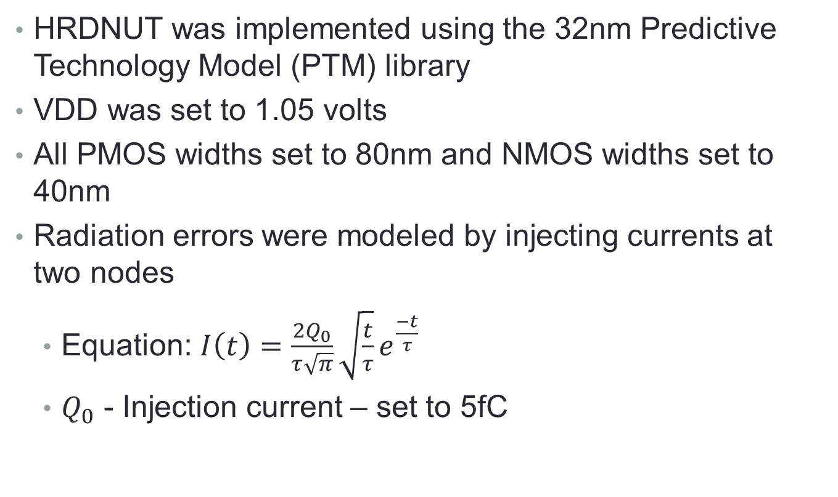
Simulation Results
HRDNUT was implemented using the 32nm Predictive Technology Model (PTM) library
VDD was set to 1.05 volts
All PMOS widths set to 80nm and NMOS widths set to 40nm
Radiation errors were modeled by injecting currents at two nodes
Equation: $I\left(t\right)=\frac{2Q_{0}}{τ\sqrt{π}}\sqrt{\frac{t}{τ}}e^{\frac{−t}{τ}}$
$Q_{0}$ - Injection current – set to 5fC

Slide 12
Simulation Results
Waveforms of two internal nodes with simultaneous SEUs
Waveforms of the CLK and Data signals
Waveforms of an internal node and the output with simultaneous SEUs

Slide 13
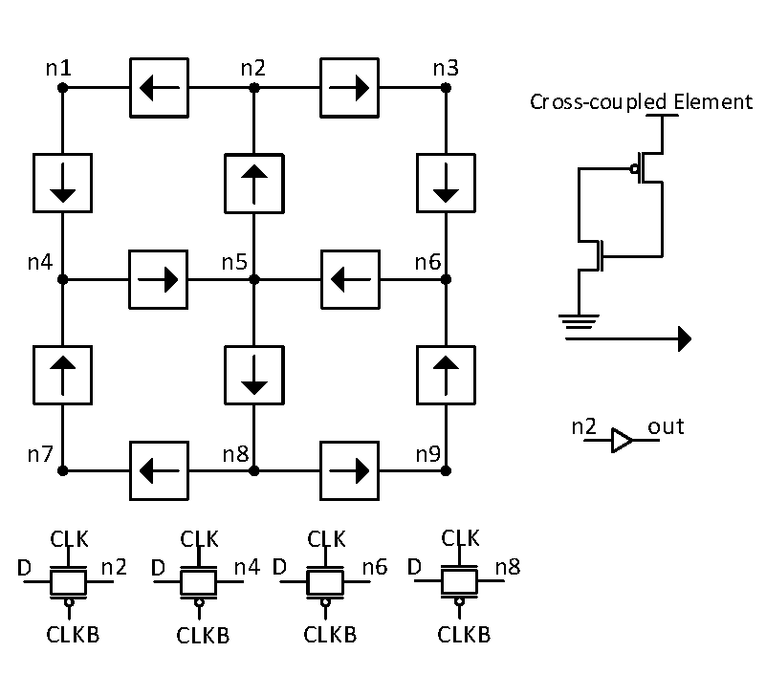
Existing DNU Robust Design
Existing DNU robust design is the DONUT latch
Uses 12 cross-coupled elements
The device recovers all nodes after a DNU – DNU robust
HRDNUT improves on the DONUT by offering lower power and delay
DONUT Latch [3]
[3] N. Eftaxiopoulos et al, Donut: A double node upset tolerant latch, 2015

Slide 14
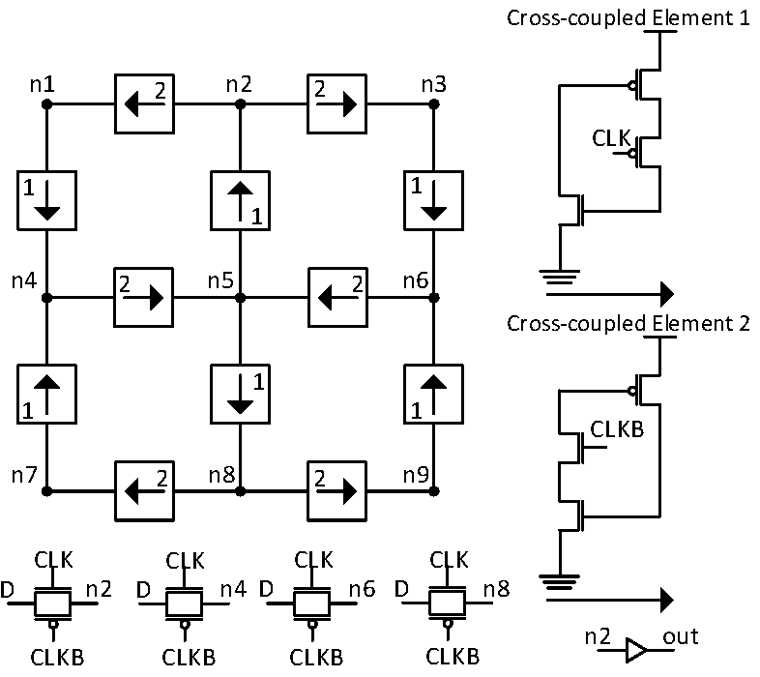
Modified DONUT Latch
Standard DONUT latch has relatively high power and delay
Was due to contention on data lines during the transparent mode
Transistors were added to put all data loading nodes to high impedance during the transparent mode
Saved power and decreased delay at a cost of area
Modified DONUT Latch

Slide 15
Comparison to Existing Designs
HRDNUT has been extensively compared to existing designs in power, area and delay
All designs implemented with the following
PMOS Width: 80nm
NMOS Width: 40nm
If a weak keeper is used the output c-element was sized
PMOS Width: 320nm
NMOS Width: 160nm
Area is represented as unit sized transistors (UST) which is the number of minimum width transistors (40nm)

Slide 16
Comparison to Existing Designs
Latch | DNU Immune | DNU Robust | Power (µW) | Delay (ps) | Area (UST)
DICE | No | No | 1.332 | 8.145 | 16
FERST | No | No | 3.178 | 31.648 | 60
HIPER | No | No | 1.292 | 2.221 | 27
DNCS | Yes | No | 4.948 | 22.486 | 61
HSMUF | Yes | No | 1.871 | 1.0626 | 51
HSMUF (Keeper) | Yes | No | 3.787 | 3.945 | 78
DONUT | Yes | Yes | 4.021 | 14.722 | 54
DONUT (Modified) | Yes | Yes | 2.760 | 8.421 | 72
HRDNUT | Yes | Yes | 2.450 | 2.310 | 66

Slide 17
Triple Node Upsets
Further scaling may lead to more multi-node upsets
A possible issue is the triple node upset (TNU)
Triple Node Upset – one or more particles causing 3 simultaneous transient pulses
A latch showing promise as TNU tolerant was designed
Has 11 nodes – 165 possible TNU cases
May also be TNU robust

Slide 18
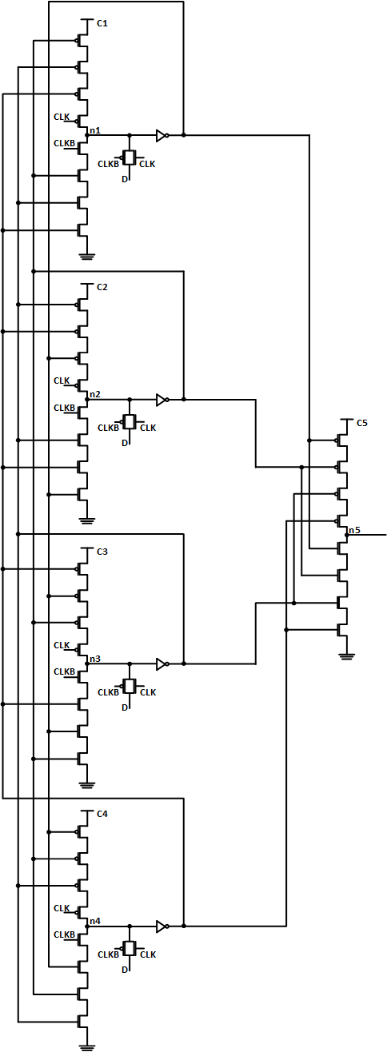
TNU Block Latch
TNU block latch
Uses block latch as a basis
Has 4 cross-connected blocks
Is not TNU tolerant by default
Additional C-elements added as in HRDNUT
Has 36 transistors
Requires a 35% transistor overhead compared to the HRDNUT block latch

Slide 19
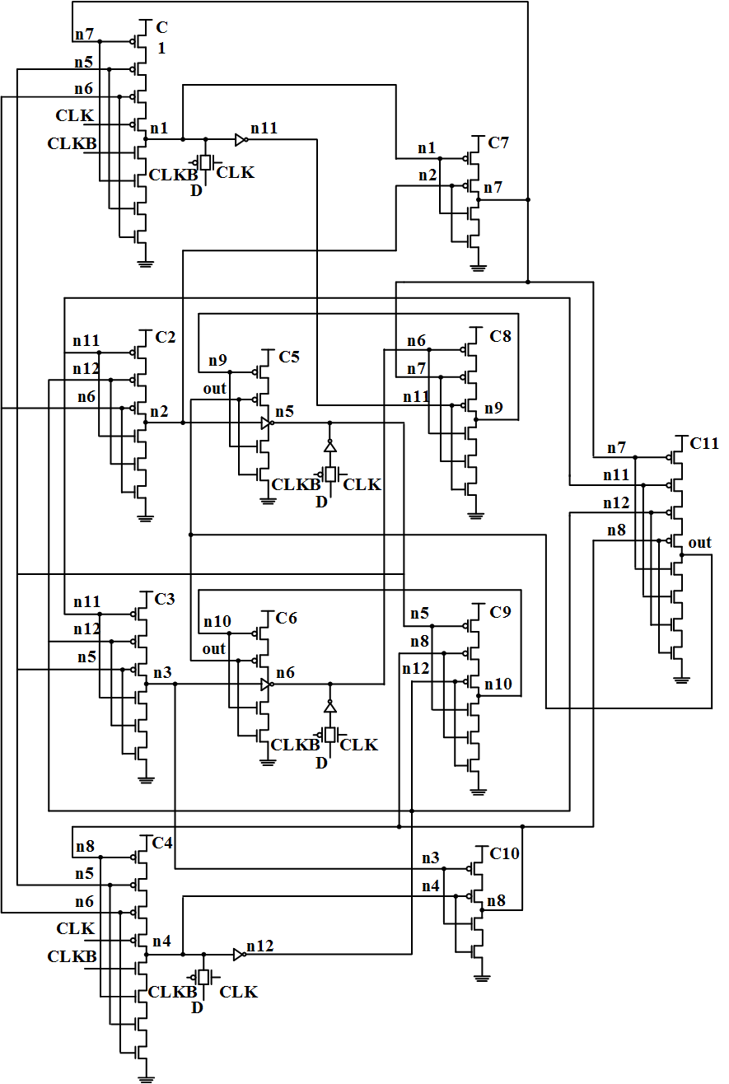
TNU Tolerant Latch
Block latch was modified to provide tolerance
Has 84 total transistors
Is SNU and DNU robust since it is based on HRDNUT
Shows promise as TNU robust

Slide 20
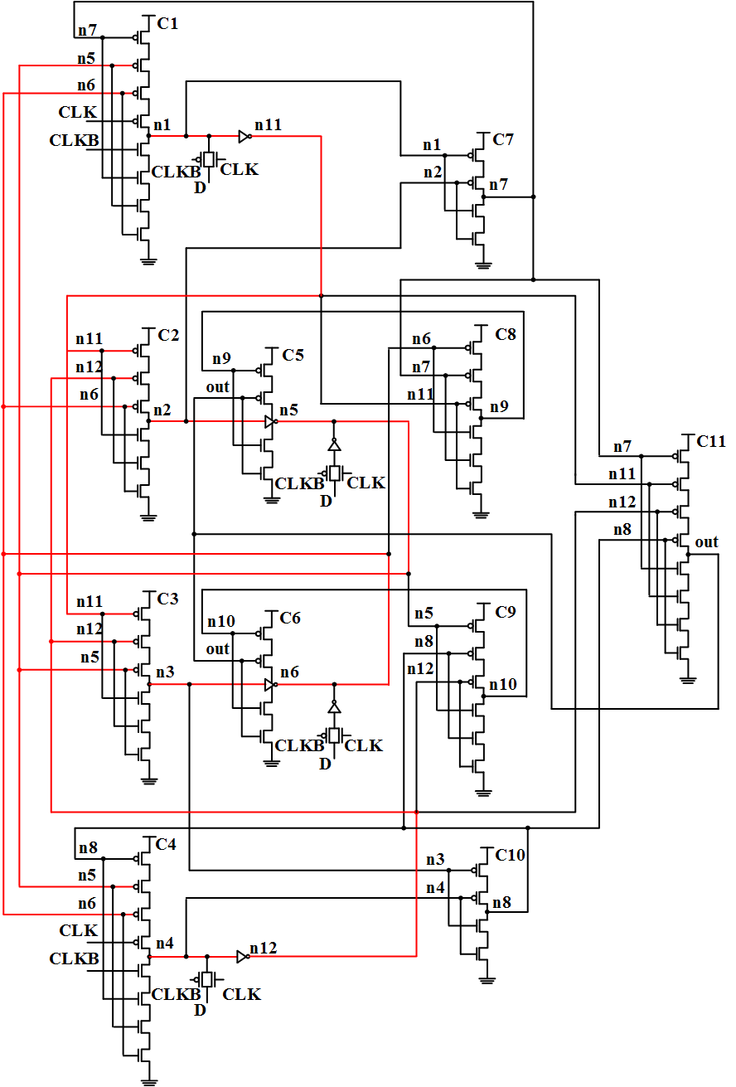
TNU Latch Normal Mode
Transparent Mode
4 pass gates are activated
Transistors connect to CLK and CLKB set n1 and n4 to high impedance
n5 and n6 are loaded with data through the pass gates
Hold Mode
Pass gates are deactivated
Data is held in the latch
Data loop shown in red

Slide 21
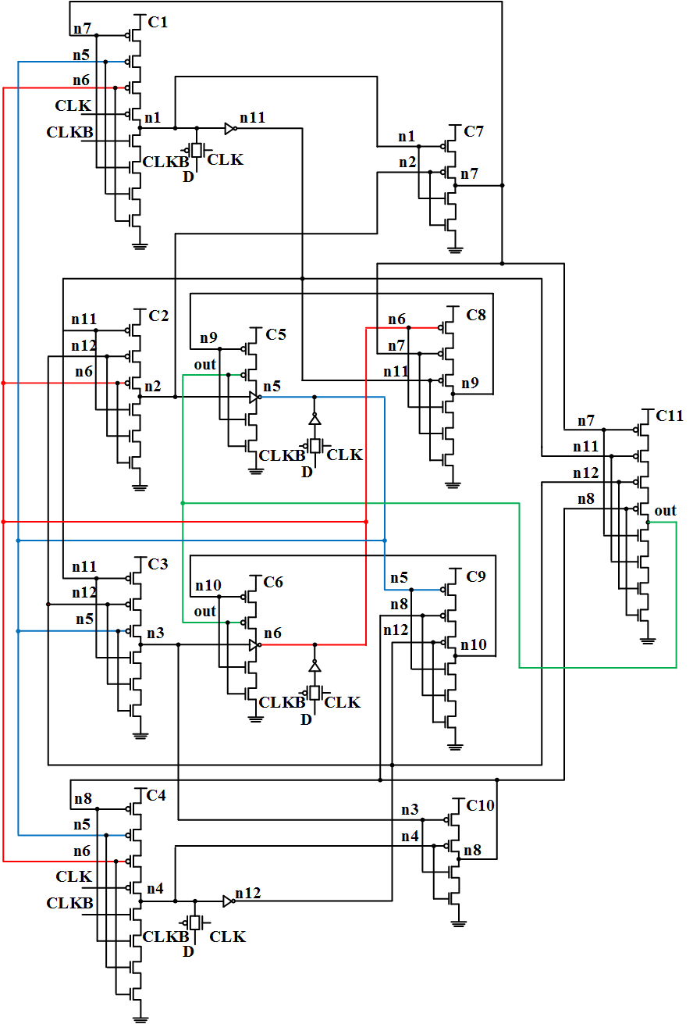
Latch During a TNU
Assume a TNU occurs on out, n5 and n6
Transient on n5 (blue)
Arrives at C1, C3, C4 and C9
Transient on n6 (red)
Arrives at C1, C2, C4 and C8
Transient on out (out)
Arrives at C5 and C6
out fully recovers
C5 and C6 drive n5 and n6 to correct value

Slide 22
TNU Tolerant Latch Implementation
Implemented in HSPICE using the 32nm PTM library
All transistor widths set to minimum
NMOS – 40nm
PMOS – 80nm
Device operated at 1Ghz and 1.05V
Average Power – 4.09 µW
Unit Sized Transistors (UST) – 129
Delay – 2.77 ps
Consumes 60% more power with double area and delay overheads compared to the HRDNUT

Slide 23
General Design Rules
A latch tolerating n errors require n+1 blocks
Each block has at least one Muller c-element with n inputs
At least one block has two Muller c-elements with n inputs
No device should drive itself
Intermediary Muller c-elements must be inserted between the blocks and output
Output must be used in the circuit
n+1 nodes must be driven to load data
At least one node must be driven to high impedance during transparent mode

Slide 24
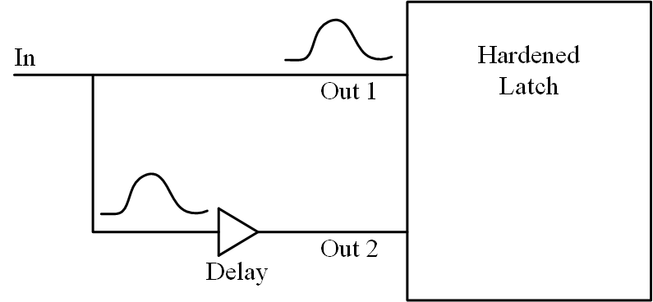
Transient Pulse Filtering
Pulses arriving on the input can be filtered
Existing design uses a delay element
Operation
Pulse arrives on In
Propagates directly to out1
Is delayed to out2
No overlap – no error
Vulnerable to error during the filtering stage
Pulse can be generated at the delay element
Pulse Filter Circuit

Slide 25
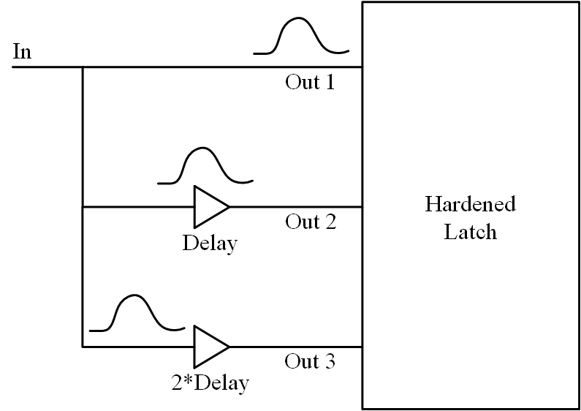
Enhanced Filter Circuit
Additional delay element is added
Has twice the delay
Assume a single error on out2
out1 and out2 overlap
out3 has no error, input transient filtered
Implement in HSPICE with 32nm PTM library
Power consumption – 3.15 µW
Delay – 40 ps
Is 2*delay
Enhanced Filter Circuit

Slide 26
Latch Designs - Conclusion
The HRDNUT was proposed which is DNU robust
Consumes 11.3% less power and reduces the delay by 72.5% compared to the modified DONUT latch
Suitable for high radiation environments where clock gating is used
A TNU tolerant latch was investigated
Consumes 60% more power compared to HRDNUT
Has double the delay and area
A pulse filtering circuit was designed
Allows for the filtering of input pulses
Is tolerant to a single error during filtering mode

Slide 27
Outline
Introduction
Robust Latch for Multiple Node Upsets
Analytical Approximation Model for Multiple Transients
Accurate Soft Error Simulation Using Partitioning
Conclusion

Slide 28
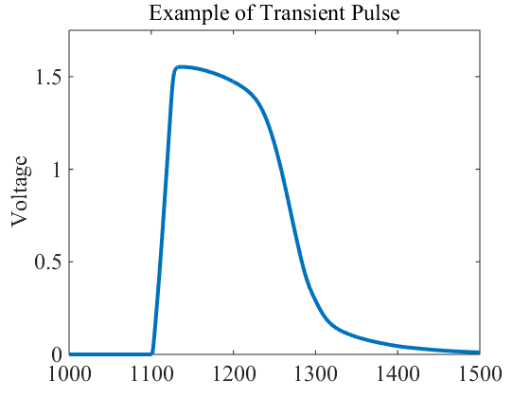
Analytical Approximation Model
Proposed model calculates the output pulse shape at a gate
Problems with existing methods
Simple – Trapezoidal and square approximation
A transient pulse does not take these shapes
Can only consider a single transient on the input
Decrease in feature size has led to more pulses
More generated pulses – more errors on gate inputs
Proposed model can consider multiple input pulses accurately
Actual Transient Pulse Shape

Slide 29
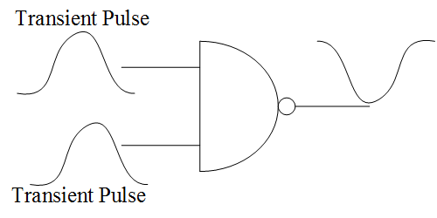
Analytical Approximation Model
Based on an existing method for a single pulse
Does not fit using a predetermined shape
Approximates voltage by iterating over time
Uses look up tables for the transistor current
Uses static Miller and load capacitances
Can consider multiple pulses on inputs
Most accurate existing method for multiple pulses
Multiple Transient Pulses on Gate Input

Slide 30
Gate Model
Transistors represented with Miller capacitor between gate and drain
Each transistor represented as a current source
Current source is the I_{DS} current
Can convert a gate to equivalent circuit for analysis
The currents are found using a look up table
Tables are indexed by V_{GS} and V_{DS}
Transistor Model
Converted Gate

Slide 31
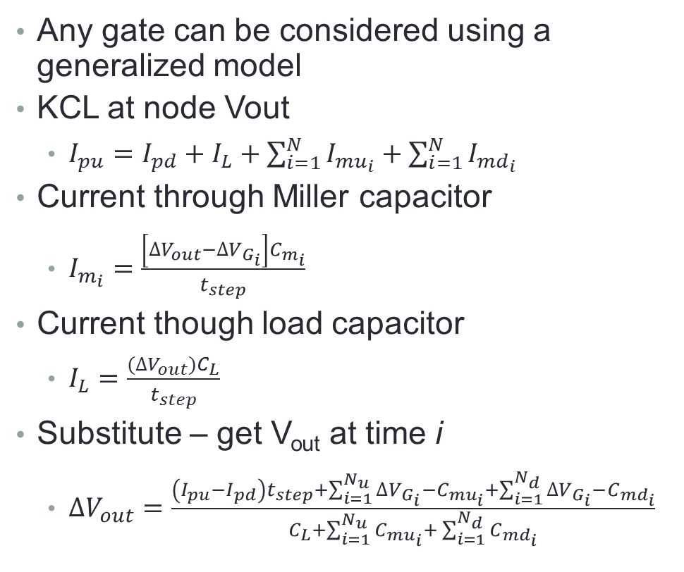
Derivation of Equation
Any gate can be considered using a generalized model
KCL at node Vout
$I_{pu}=I_{pd}+I_{L}+\sum_{i=1}^{N}{I_{{mu}_{i}}}+\sum_{i=1}^{N}{I_{{md}_{i}}}$
Current through Miller capacitor
$I_{m_{i}}=\frac{\left[{∆V}_{out}−{∆V}_{G_{i}}\right]C_{m_{i}}}{t_{step}}$
Current though load capacitor
$I_{L}=\frac{({∆V}_{out})C_{L}}{t_{step}}$
Substitute – get V_{out} at time i
$∆V_{out}=\frac{\left(I_{pu}−I_{pd}\right)t_{step}+\sum_{i=1}^{N_{u}}{∆V_{G_{i}}−C_{{mu}_{i}}}+\sum_{i=1}^{N_{d}}{∆V_{G_{i}}−C_{{md}_{i}}}}{C_{L}+\sum_{i=1}^{N_{u}}{C_{{mu}_{i}}}+ \sum_{i=1}^{N_{d}}{C_{{md}_{i}}}}$
Generalized Model

Slide 32
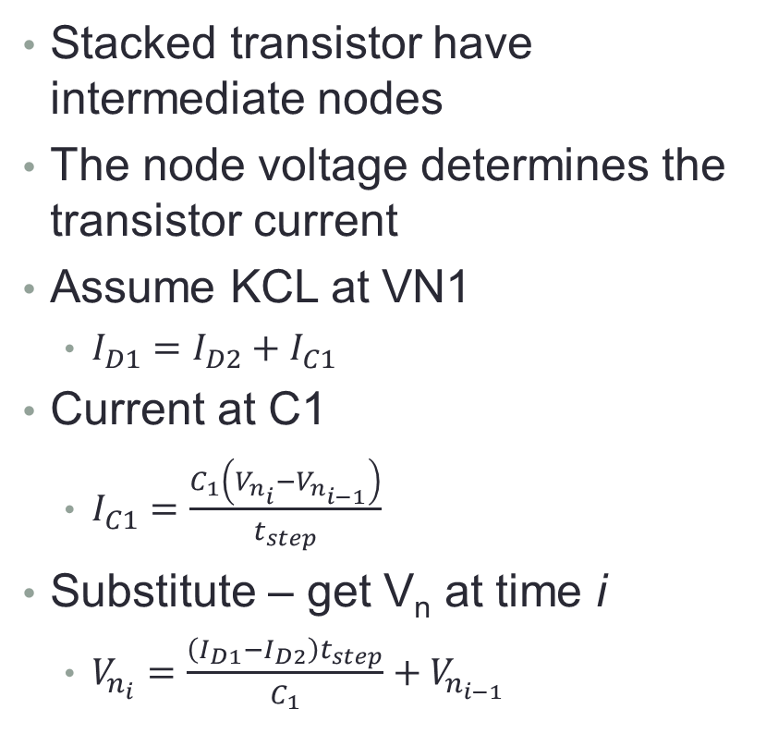
Consideration of Stacked Transistors
Stacked transistor have intermediate nodes
The node voltage determines the transistor current
Assume KCL at VN1
$I_{D1}=I_{D2}+I_{C1}$
Current at C1
$I_{C1}=\frac{C_{1}\left(V_{n_{i}}−V_{n_{i−1}}\right)}{t_{step}}$
Substitute – get V_{n} at time i
$V_{n_{i}}=\frac{\left(I_{D1}−I_{D2}\right)t_{step}}{C_{1}}+V_{n_{i−1}}$
Transistor Model for Stacked Nodes

Slide 33
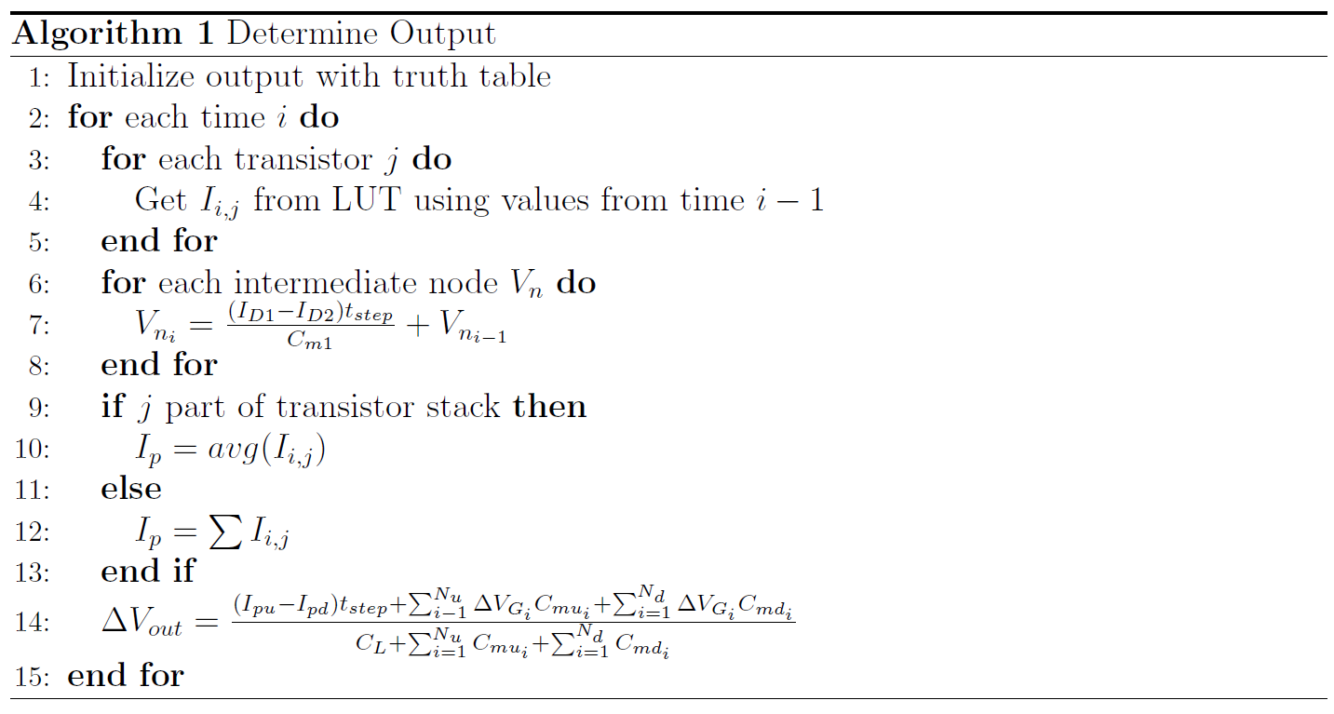
General Simulation Flow

Slide 34
Results
Proposed model tested in HSPICE with the PTM library
3 test circuits created
NAND2 – 2 input NAND driven by 2, 2 input NAND gates
NOR2 – 2 input NOR driven by 2, 2 input NOR gates
NAND3 – 3 input NAND driven by 2, 2 input NAND gates
Pulses were generated on both input gates and their result calculated
Compared to HSPICE and an existing approximation model
Existing model cannot consider multiple pulses
NAND2 Circuit

Slide 35
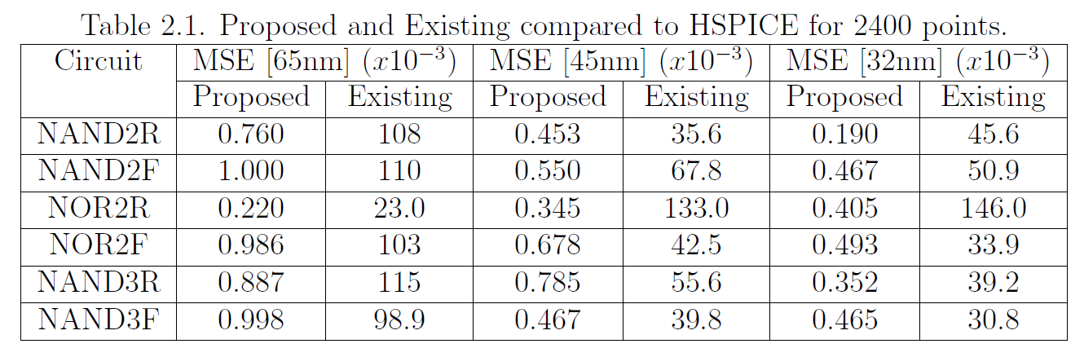
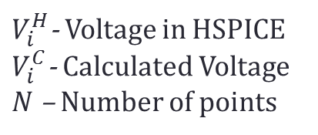
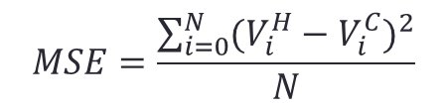
Results
$V_{i}^{H}$- Voltage in HSPICE
$V_{i}^{C}$- Calculated Voltage
$N$ – Number of points
$$MSE=\frac{\sum_{i=0}^{N}{{(V_{i}^{H}−V_{i}^{C})}^{2}}}{N}$$

Slide 36
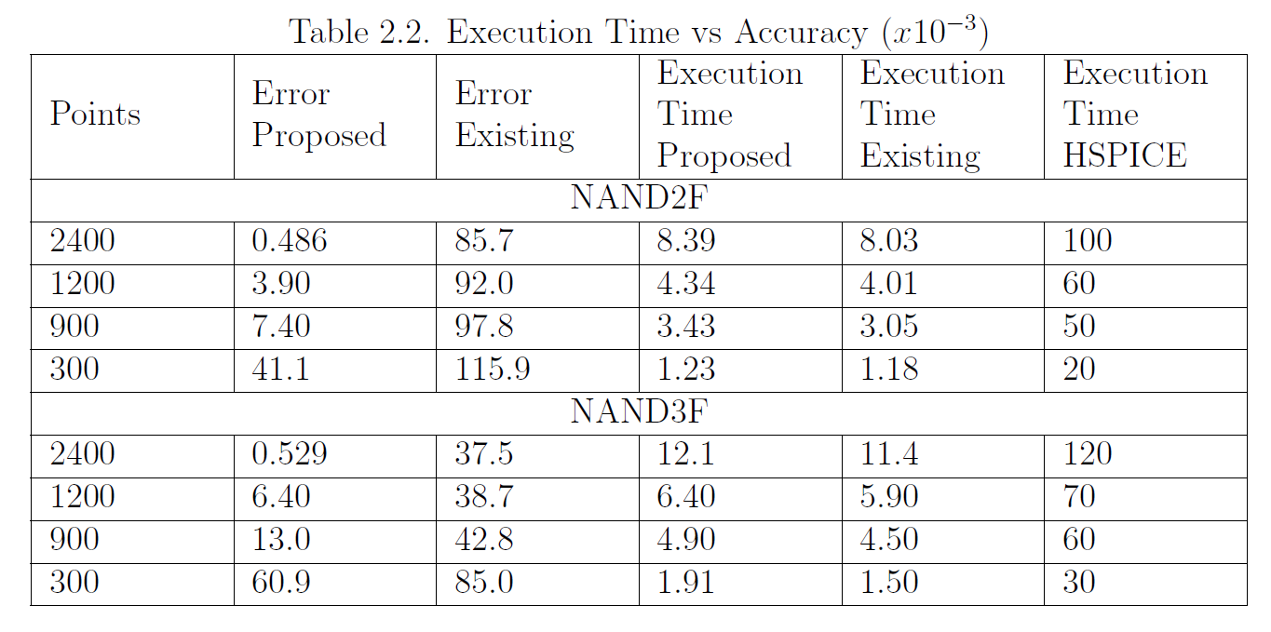
Results

Slide 37
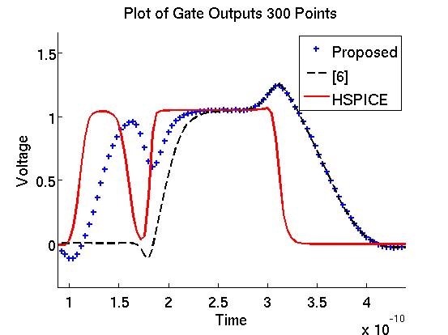
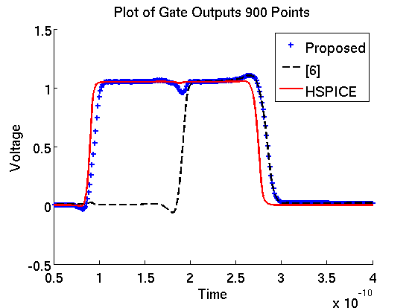
Results
Comparison of the result out of 2400 possible points

Slide 38
Pulse Approximation - Conclusion
A new method to approximate the pulse shape with multiple input pulses was proposed
Achieves a speed-up of up to 15X compared to HSPICE while also maintaining high accuracy
Designed to be used in simulators for improved soft error rate estimation

Slide 39
Outline
Introduction
Robust Latch for Multiple Node Upsets
Analytical Approximation Model for Multiple Transients
Accurate Soft Error Simulation Using Partitioning
Conclusion

Slide 40
Accurate Soft Error Simulation
Proposed simulator can accurately and quickly determine the soft error rate (SER)
SER = P(e) * R_{eff} * P_{eff} * A
P(e) – probability of an error on an output
R_{eff} - effective particle concentration
P_{eff} - probability of particle hitting sensitive region
A – area of the circuit
P(e) difficult to attain due to 3 masking factors
Logical masking – a controlling value on an off-input forces the output to a value
Electrical masking – gate’s transfer function masks the pulse
Temporal masking – pulse does not meet set up and hold time parameters

Slide 41
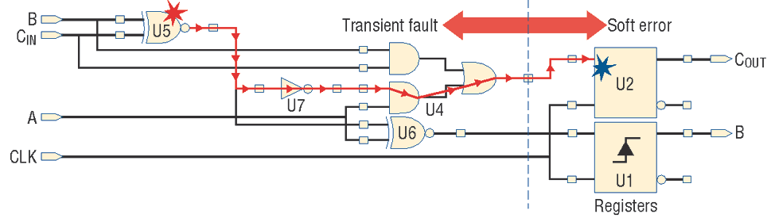
Soft Error Simulation
Soft error simulation on combinational circuits consists of 3 parts
Pulse Injection – an equation is used to relate the injected charge to a pulse
Pulse Propagation – pulse is propagated through the circuit
Latching Evaluation – it is determined at the output device if the pulse is stored
Borrowed From: Mitra et al, Robust System Design with Built-In Soft-Error Resilience, 2005

Slide 42
Accurate Soft Error Simulation
Existing simulators
Use inaccurate or slow methods to find logical masking effects
Use simple electrical masking models
Most do not consider multiple event transients (METs)
None use an accurate masking model for METs
Proposed simulator uses binary decision diagrams (BDDs) for exact logical masking determination
Uses previously proposed electrical masking model
Called the FAST_MET simulator
Fast and Accurate Simulation Tool for Multiple Event Transients

Slide 43
BDD Preliminaries
All functions are represented in BDDs
BDD – canonical form to store a Boolean function
Advantages
Efficiently stores all input patterns to a circuit
Operations can be applied quickly
Disadvantages
Memory blow up
More complicated than randomly applying patterns
Many existing packages to mitigate this
Example of BDD function for AND gate

Slide 44
Pulse Generation
Pulse generated depends on input pattern
2 types of pulses
Rising – low to high value
Requires a “0” for the output value
Falling – high to low value
Requires a “1” for the output value
Functions are determined using signal probability BDDs
Signal probability BDD – the function representing all patterns that make a line a “1” or “0” value
Each generated pulse event is represented at E_{k}

Slide 45
Pulse Generation
The input functions represent the logic values on the inputs
Top example
Output must be “0”
All paths to “0” on Fo represent cases were the pulse is generated
BDD is inverted, all paths to “1” represent pulse generation
Bottom Example
Output must be “1”
All paths to “1” on Fo represent cases were the pulse is generated
BDD is not inverted

Slide 46
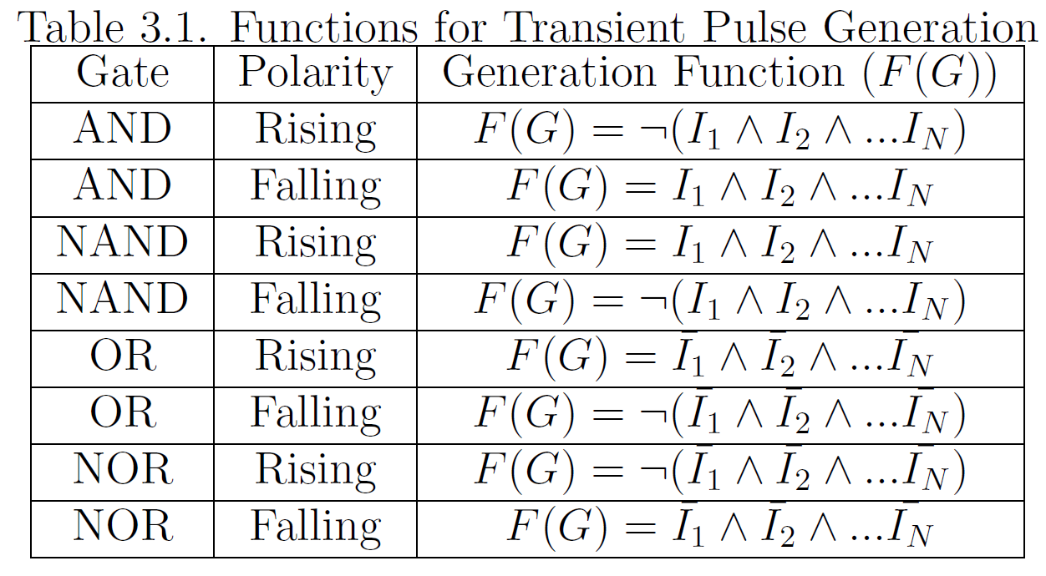
Pulse Generation
Pulse generation functions with I₁, I₂, …I_{N} as the inputs

Slide 47
Pulse Generation of METs
A MET strikes two or more gates creating multiple pulses
All gates struck must have the proper input functions
Assume F(G_{i}) is the generation function of G_{i}
F(MET) = F(G₁) & F(G₂) & …F(G_{N})
MET generation creates multiple cases
For example, 2 struck gates have the following
Pulse on gate 1 only
Pulse on gate 2 only
Pulse on gate 1 and 2
All cases must be considered

Slide 48
Pulse Propagation
Generated pulses propagate through a circuit
Pulses will be masked if off-input is controlling
Each pulse is assigned a sensitization BDD
Sensitization BDD – BDD that represents all patterns that propagate the pulse
Assume F(S_{i}) is the sensitization BDD and F(O_{i}) is the function for a non-controlling value
F(Prop) = F(S₁) & F(S₂) &… F(S_{N}) & F(O₁) & F(O₂) &… F(O_{N})
NAND gate with a controlling 0 value

Slide 49
Pulse Propagation
Pulse propagation depends on the off-inputs
Top example
Non-controlling value is a 1 – F1 is unchanged
F2 is the sensitization function
F1 and F2 are AND’d since both cases must be true for the pulse to propagate
Bottom example
Non-controlling value is a 0 – F1 must be flipped
Both ~F1 and F2 are AND’d since both must be true

Slide 50
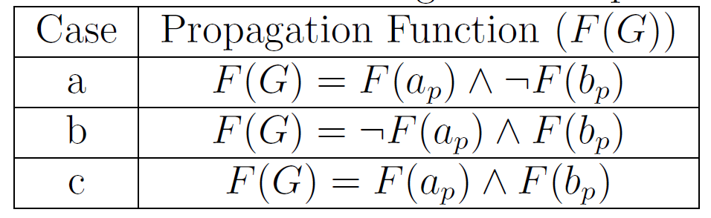
Propagation of Multiple Pulses
A MET is represented as event E_{k}
Increases the likelihood of multiple pulses from the same event arriving on gate input
If two pulses arrive, 3 cases
Pulse on a arrives
Pulse on b arrives
Pulses on a and b arrive simultaneously
All cases must be considered
Each case has a different propagation function
Three propagation cases
MET propagation functions

Slide 51
FAST_MET Partitioning
FAST_MET employs partitioning to prevent BDD blow up
In this work the Fiduccia and Mattheyses algorithm was used
Easily implemented and integrated
Partitions into 2 parts
Can be ran recursively for k-1 times for k parts
Partitioning allows faster simulation at a cost of accuracy
At a partition edge
All logic and pulse sensitization functions are solved
Solved probabilities and pulses are propagated between partitions
Virtual inputs are created for missing gate inputs
Probability is set to the logic function probability

Slide 52
FAST_MET Partitioning

Slide 53
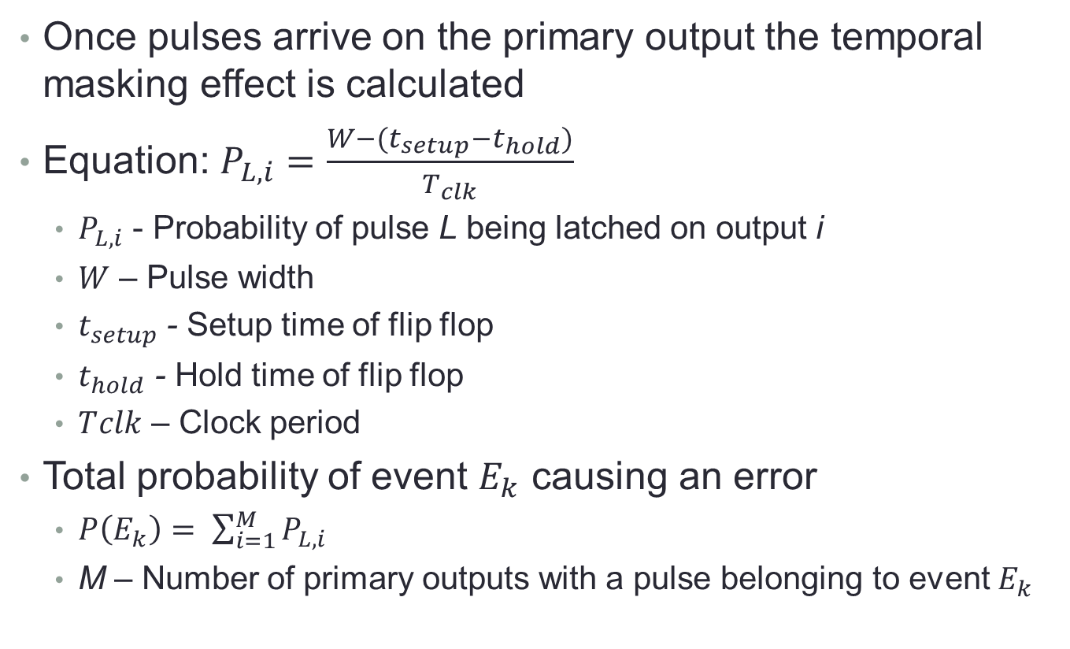
FAST_MET Output Calculation
Once pulses arrive on the primary output the temporal masking effect is calculated
Equation: $P_{L,i}=\frac{W−(t_{setup}−t_{hold})}{T_{clk}}$
$P_{L,i}$ - Probability of pulse L being latched on output i
$W$ – Pulse width
$t_{setup}$ - Setup time of flip flop
$t_{hold}$ - Hold time of flip flop
$T﷮clk$ – Clock period
Total probability of event $E_{k}$ causing an error
$P\left(E_{k}\right)= \sum_{i=1}^{M}{P_{L,i}}$
M – Number of primary outputs with a pulse belonging to event $E_{k}$

Slide 54
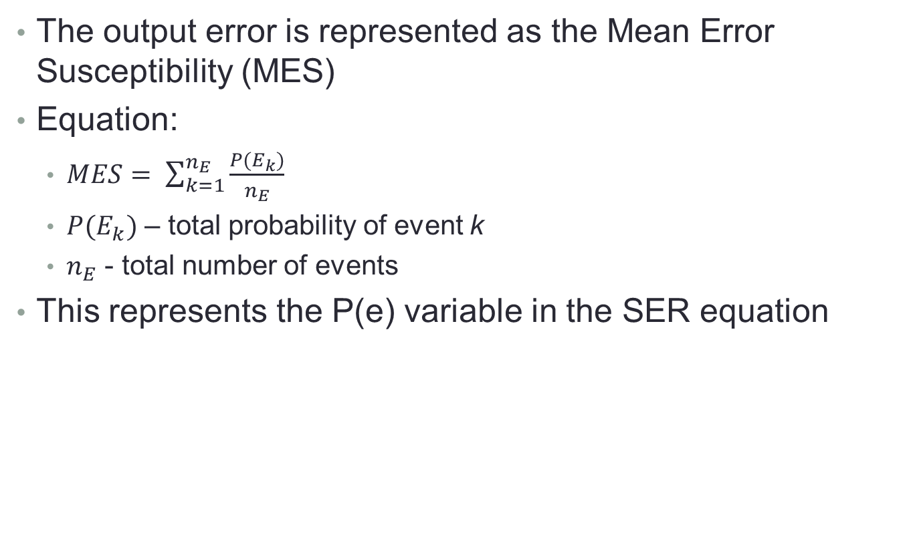
FAST_MET Output Calculation
The output error is represented as the Mean Error Susceptibility (MES)
Equation:
$MES= \sum_{k=1}^{n_{E}}{\frac{P(E_{k})}{n_{E}}}$
$P(E_{k})$ – total probability of event k
$n_{E}$ - total number of events
This represents the P(e) variable in the SER equation

Slide 55
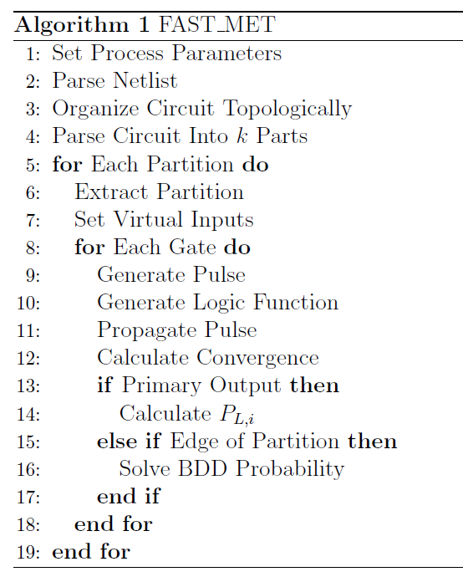
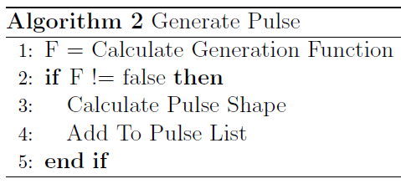
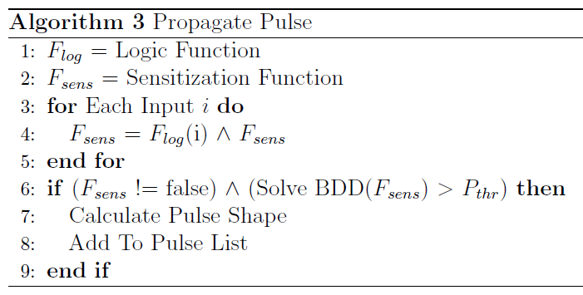
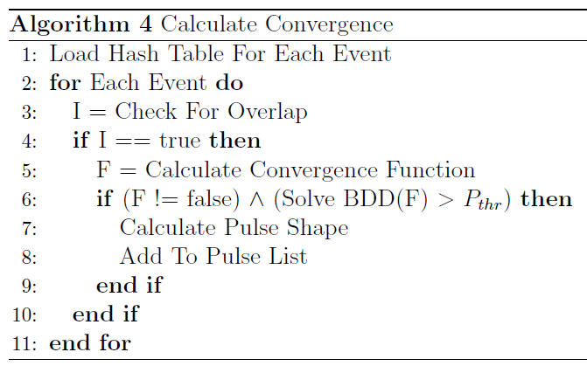
FAST_MET Algorithm

Slide 56
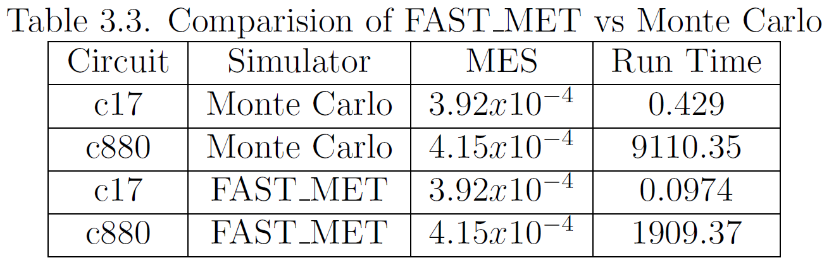
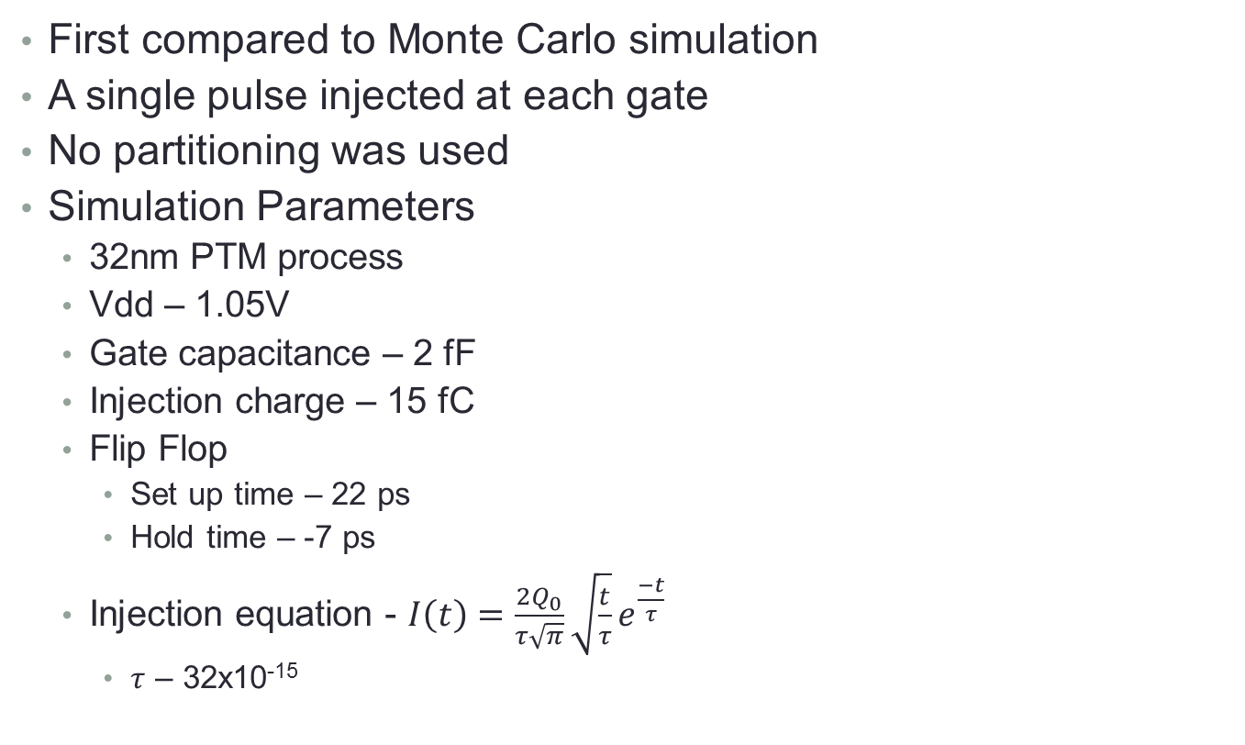
Results
First compared to Monte Carlo simulation
A single pulse injected at each gate
No partitioning was used
Simulation Parameters
32nm PTM process
Vdd – 1.05V
Gate capacitance – 2 fF
Injection charge – 15 fC
Flip Flop
Set up time – 22 ps
Hold time – -7 ps
Injection equation - $I\left(t\right)=\frac{2Q_{0}}{τ\sqrt{π}}\sqrt{\frac{t}{τ}}e^{\frac{−t}{τ}}$
$τ$ – 32x10⁻¹⁵

Slide 57
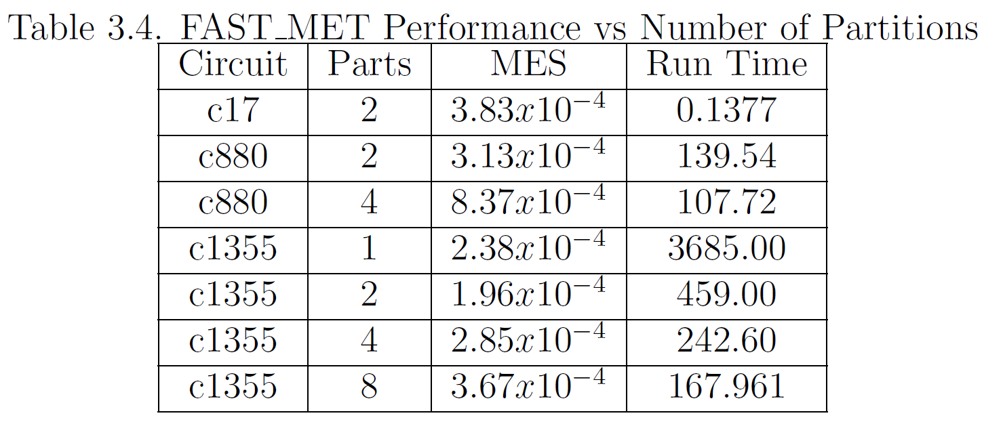
Results - Partitioning
A study of the effects on partitioning was conducted
All previous simulation parameters used
10% of injected pulses were METs
Partitioning allowed for a reduction in simulation time
Suffers from the law of diminishing returns

Slide 58
FAST_MET - Conclusion
FAST_MET is a novel simulator that calculates the SER
Can calculate the effects of METs
Is fast due to the use of partitioning
Accurate since an enhanced electrical masking model is used
Only tested with ideal parameters
Process variations can be considered using multiple circuit instances
The variations can be randomly inserted

Slide 59
Conclusion
Soft errors are a concern in circuit design
New circuit designs and simulation tools are required to handle increasing error rate
For the defense the following were discussed
A DNU tolerant latch suitable for clock gating
A promising TNU tolerant latch and the associated overheads
An enhanced pulse filtering circuit
An accurate equivalent circuit model for determining the pulse shape
A simulation tool that calculates the SER using BDDs and an accurate electrical masking model

